Slide 1

Hackathon App
Group A

Slide 2
The Team
George Brewster (Product Manager)
Travis Rinehart (Scrum Master)
Clinton Andrews
Amy Ly
Jason Hackleman
Joeseph Cutrono – stakeholder Ultimate Software

Slide 3
Hackathon App Progress
Ultimate Software hosts an internal hackathon for their employees and desires an app to help manage several aspects before and during the events. The following Features were attempted during Sprint 3:
Adding Welcome screens
Updated Admin functions and integrated Articles.
Adding comments to both projects and ideas (back-end) so that they now post according to design
Added team members to ideas and added the ability to convert an Idea to a project.
Voting mechanism upgraded with QR codes to allow for voting.
Events: tracking sub-events, adding projects and ideas to events, and events schedule.
FAQ section including FAQ response, answer identification and reporting.
Design unification throughout the app to give it a more branded and appealing look.
Worked on creating a mobile app version using Ionic.

Slide 4
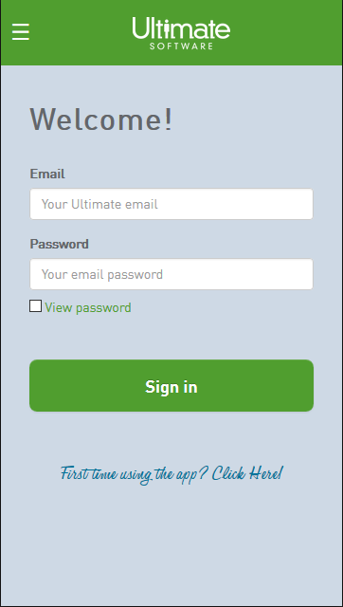
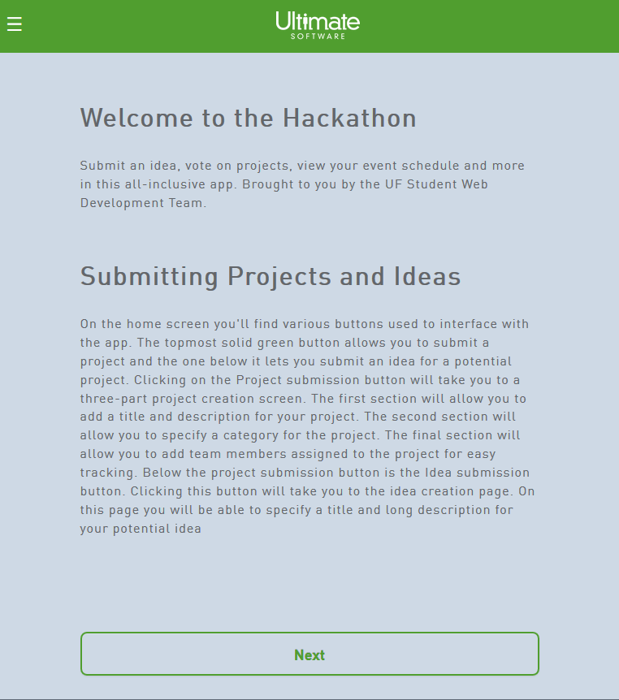
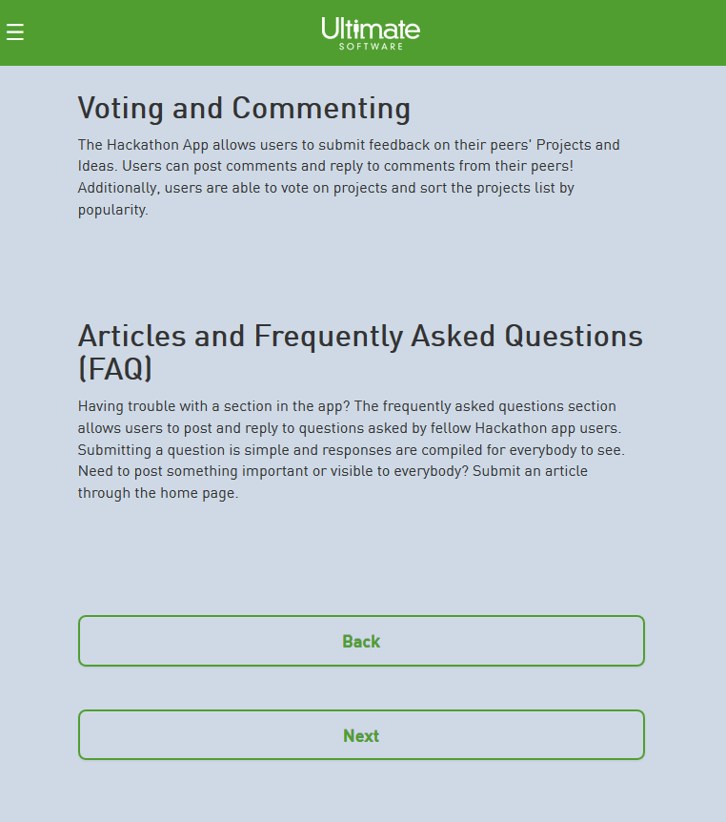
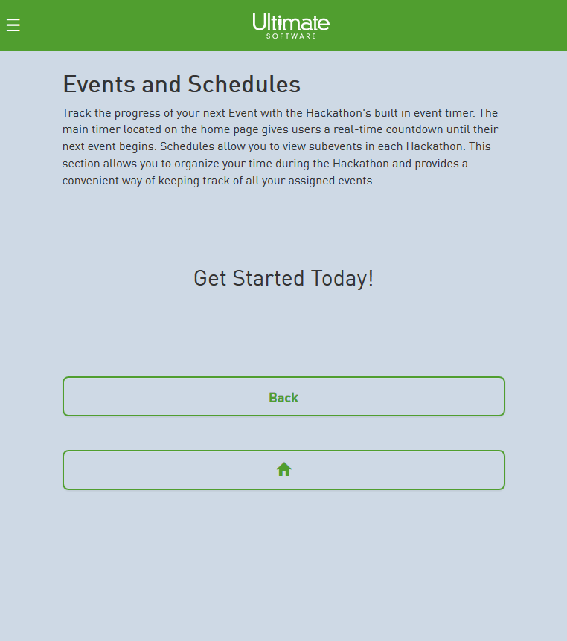
Sprint 3 – Welcome Screens
This is a series of articles to help the new user familiarize themselves with the application.
3 screens with navigation through to home/sign in.
Content information was limited at posting

Slide 5
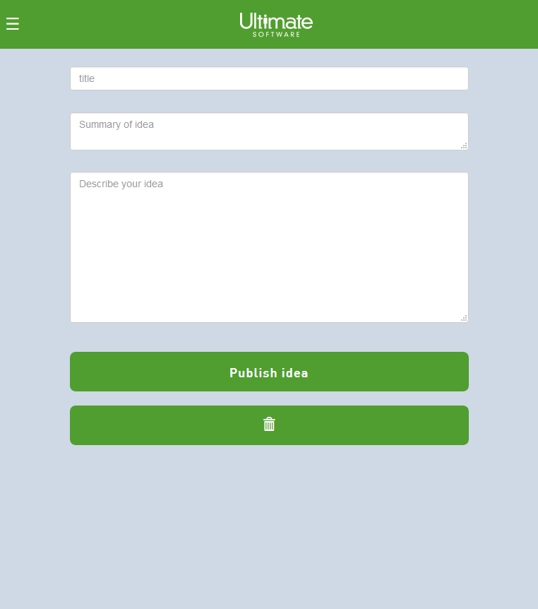
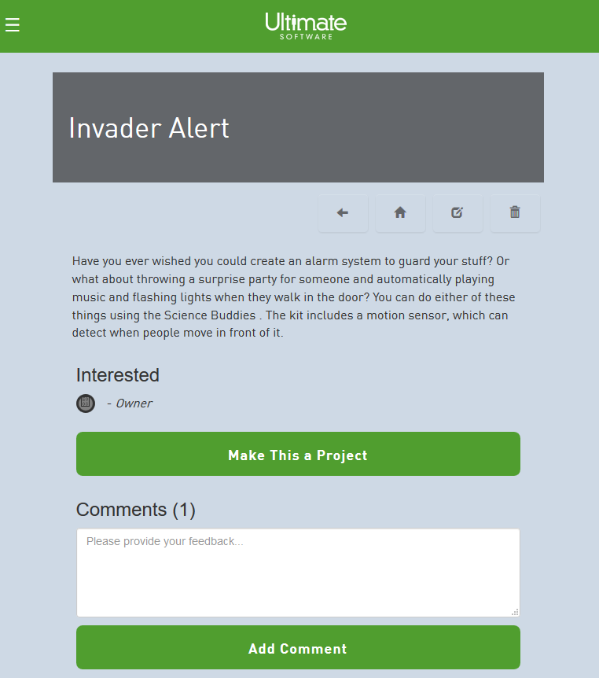
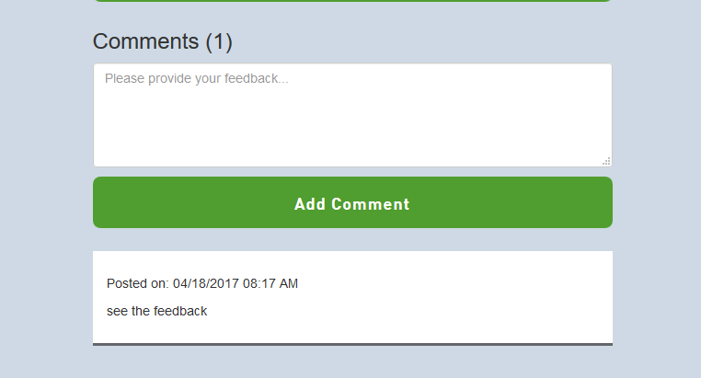
Sprint 3 – Ideas
Ideas are similar to projects which can include titles, descriptions, interest team members, and comments. An idea can be made into a project if desired.
Add an idea
Have an ability to mark an idea as a favorite.
View, edit, delete, comment and update to a project.

Slide 6
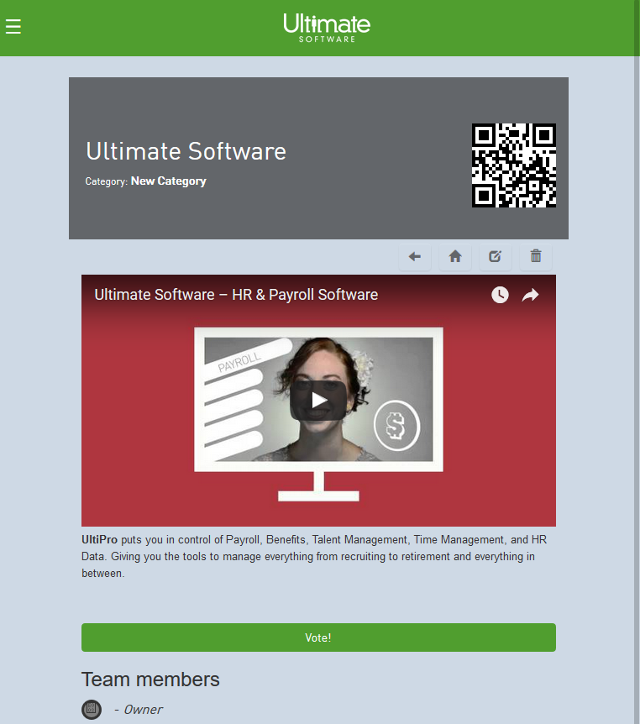
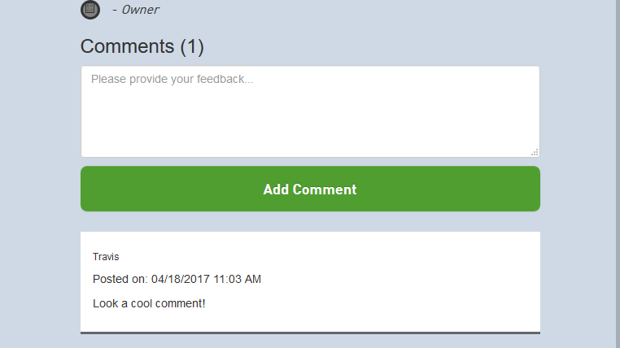
Sprint 3 – Project Updates
Projects were upgraded with the following:
Add an URL to your project
QR code generation for voting
Working comments

Slide 7
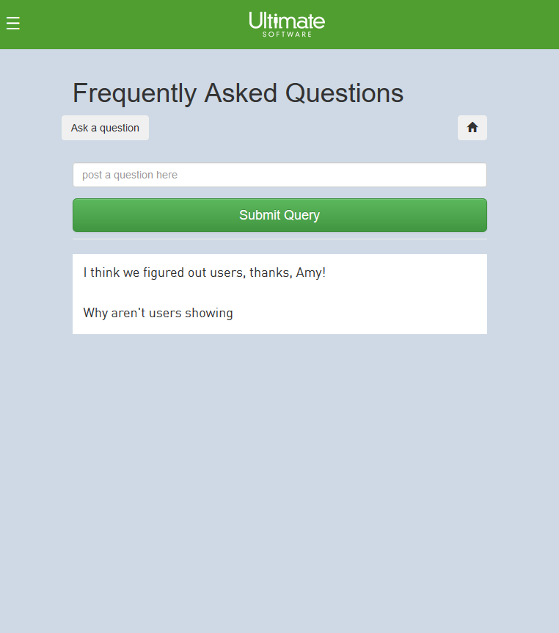
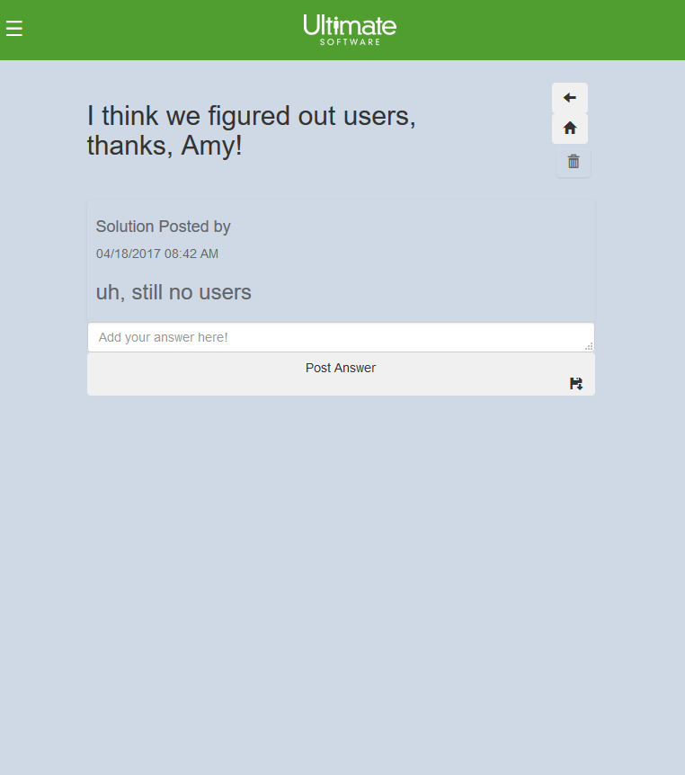
Sprint 3 – FAQs completed with replies
FAQs required the following:
Ability to post a question
Ability to respond to posted questions
Ability to mark a posted response as answered.
Did not discuss changing the name to Q & A, but easy enough change externally…we’ll talk with Joe at his demo.

Slide 8
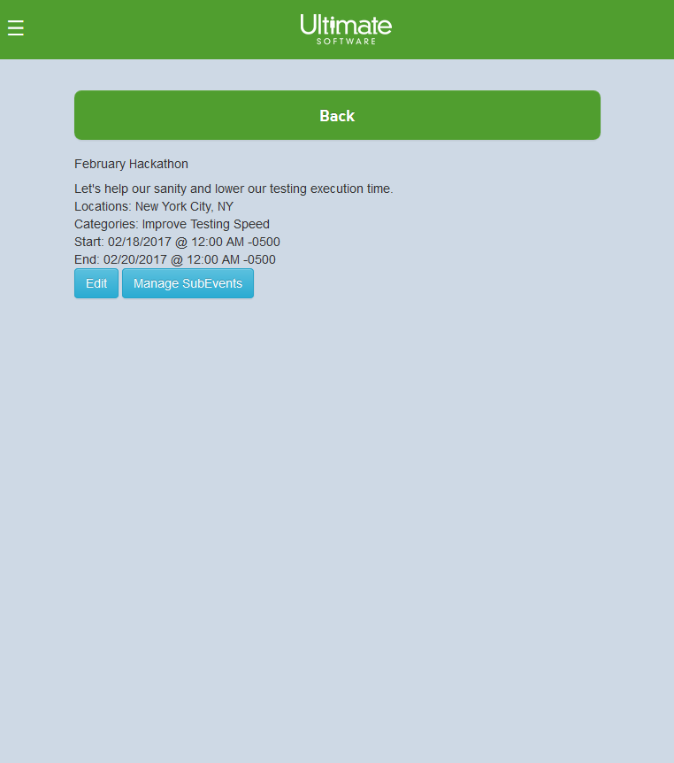
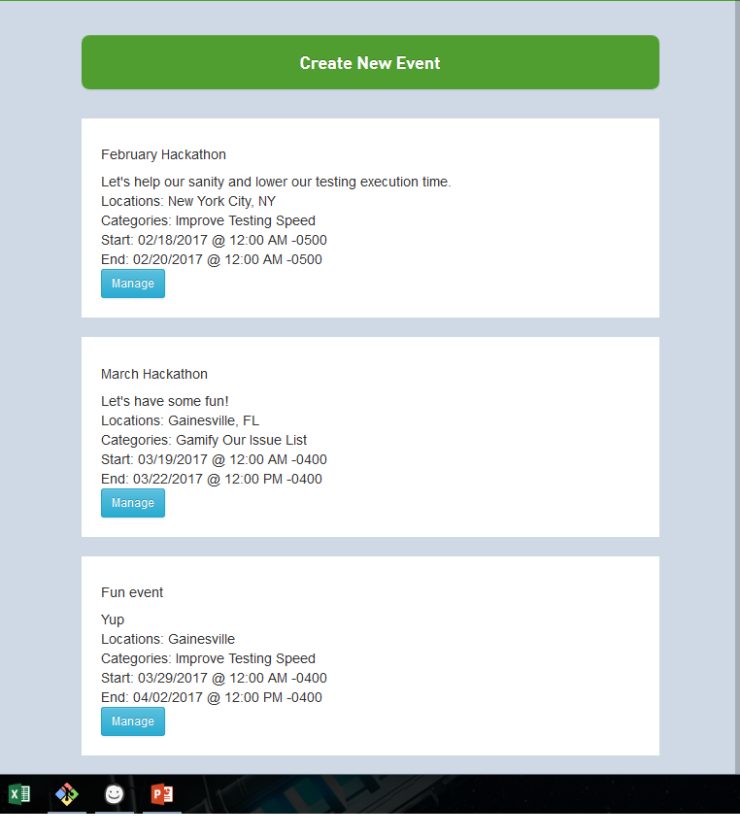
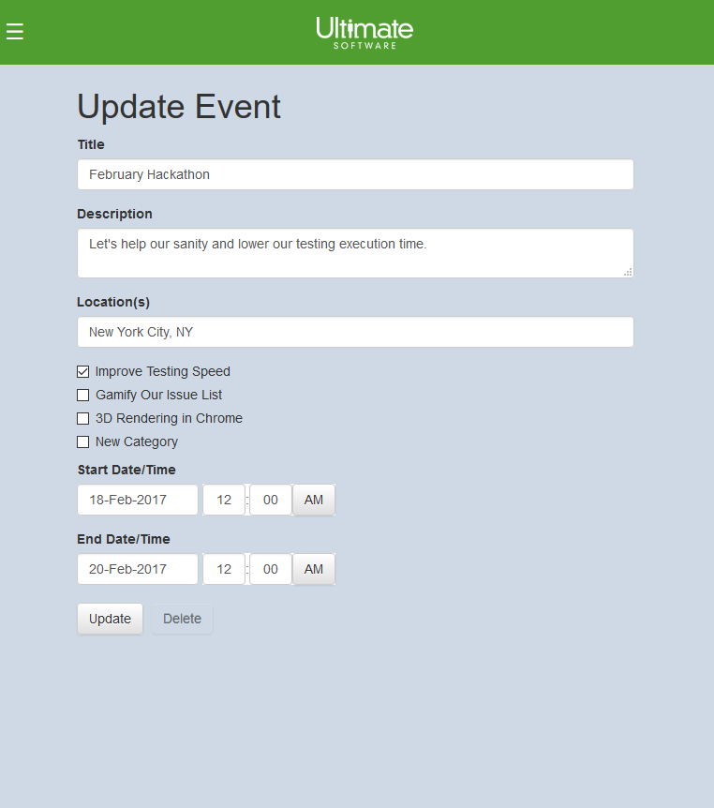
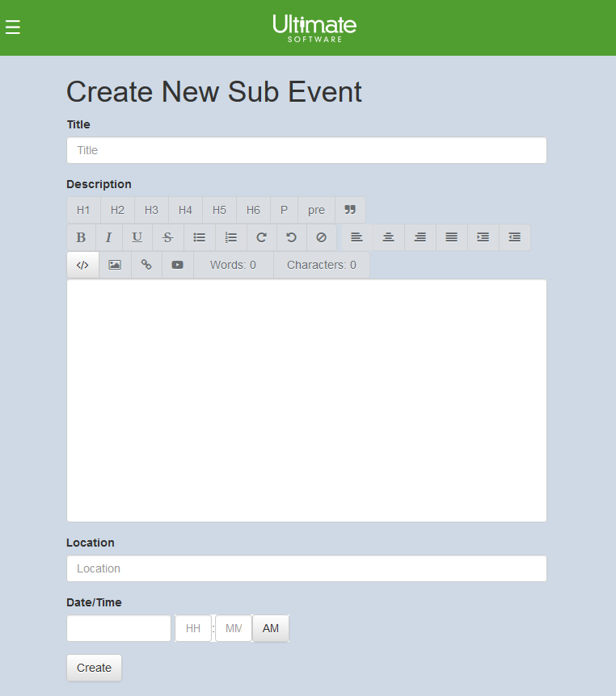
Sprint 3 – Event Updates
The sub-events were added in that tie hackathon lectures, lunches, games, etc. to a main event. These events now tie-in with the projects and ideas as well as a schedule of events.
Create main events and then add sub-events to them
Schedule allows users to pin their favorite activities.

Slide 9
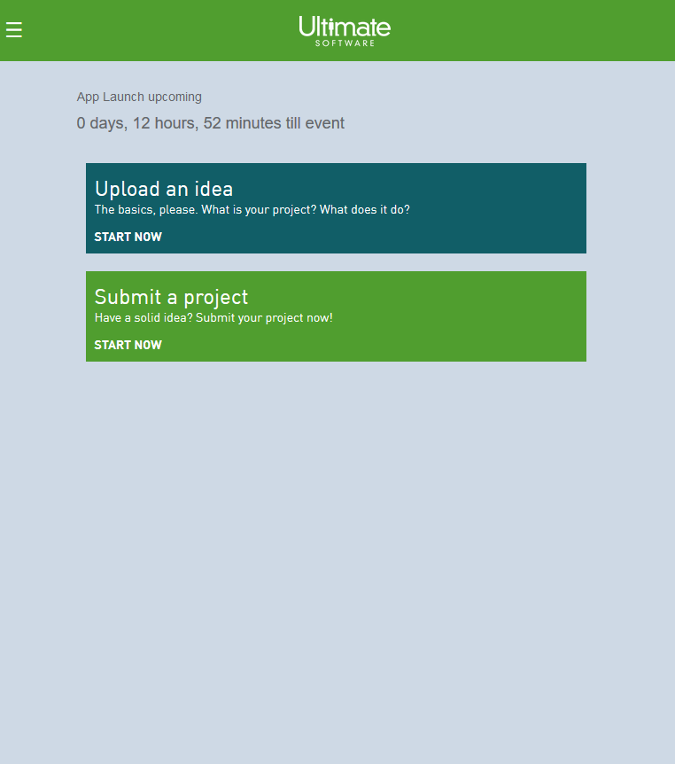
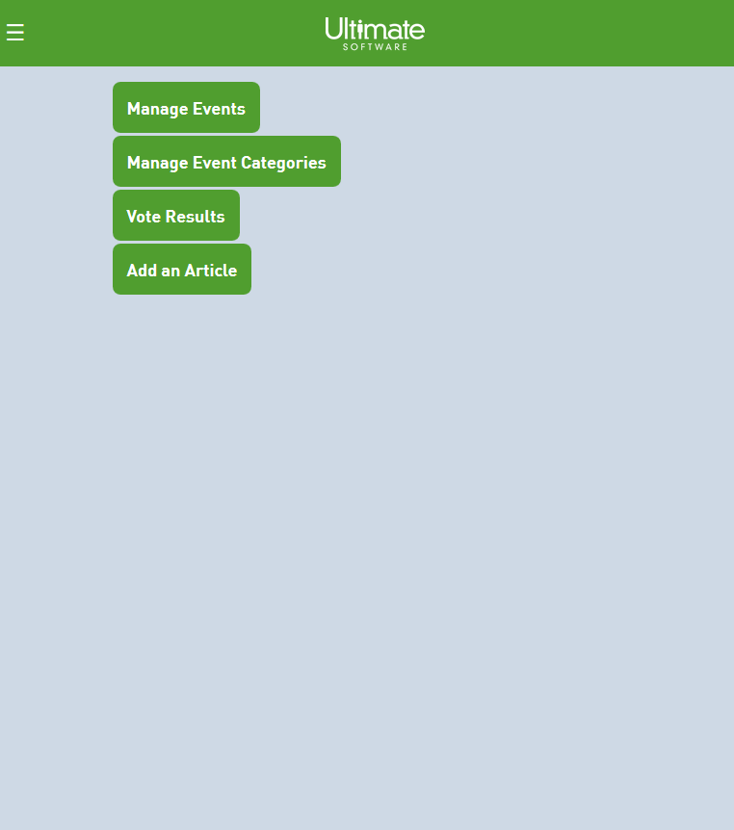
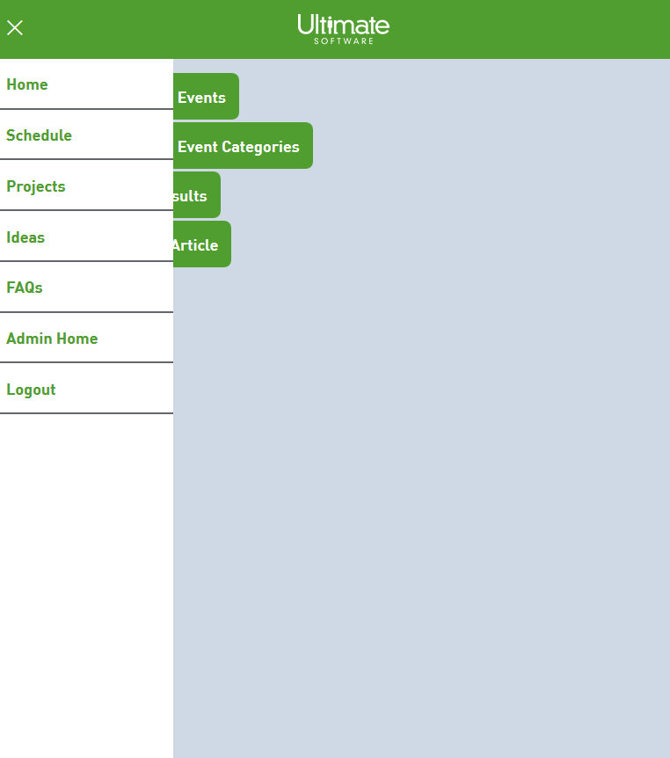
Sprint 3 – General Unification of Design
Using Ultimate Software’s branding standards, we try to meet with expectations to give the overall app a more unified and clean look.

Slide 10
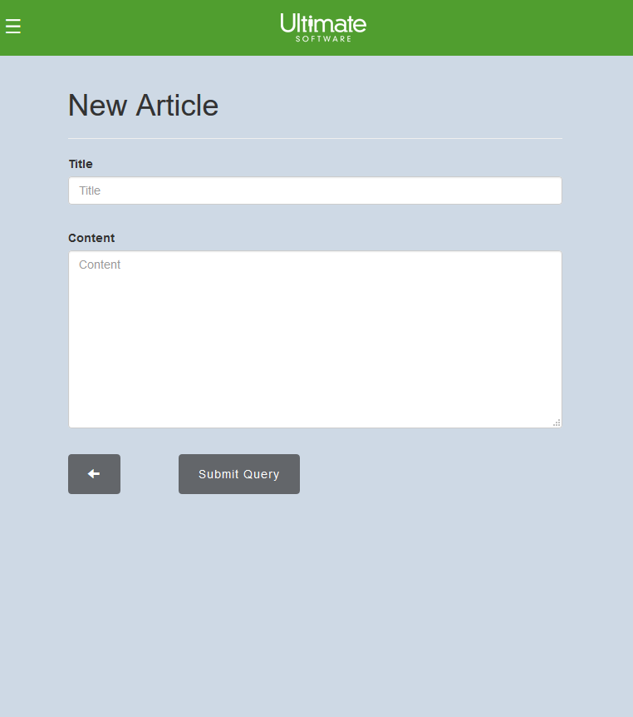
Sprint 3 – Articles
Ultimate software was requesting for a way to develop and post articles on the home screen discussing various topics. We added in this functionality and placed access to it through the admin screen.

Slide 11
Sprint 3 – Ionic Integration
Amy took on this task for Sprint 3 and I’ll let her speak to her success and challenges in developing for this platform.

Slide 12
Sprint 2 Summary
Overall, we were stronger as a team this sprint and found that we could still get a lot done in a short period of time. We have our demo with the client on Friday afternoon and hope he will be happy with the progress.
We were unable to reach some of the expected features, but overall the main meat of the application is here and usable.
Testing has been done throughout as we process our commits. Most bugs were fixed via those who found them and I’m sure there a few sneaky ones still in there.

Slide 13
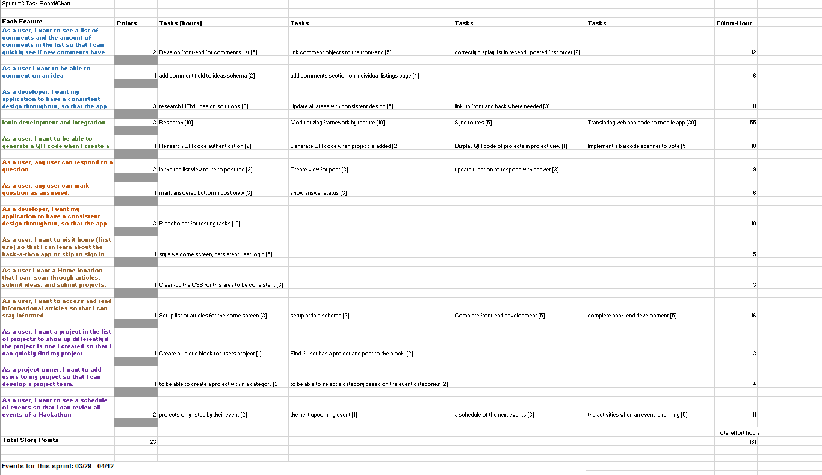
Burn-down Chart Snapshot

Slide 14
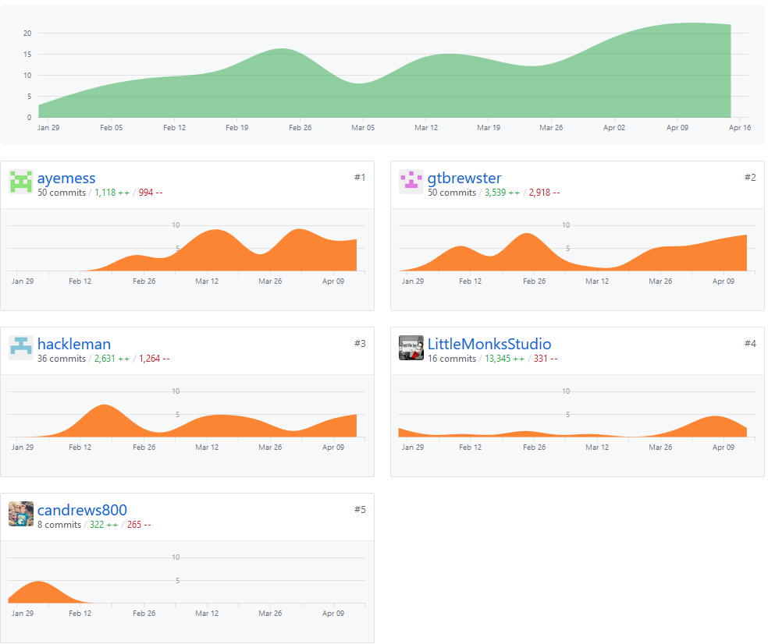
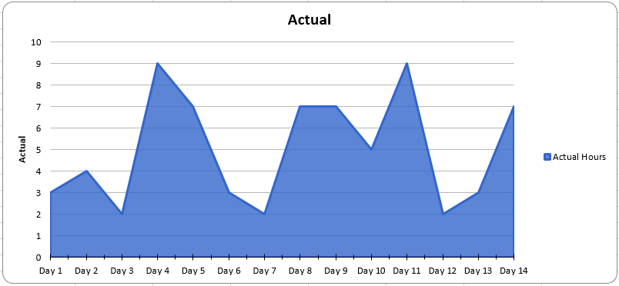
GitHub Charts & Burndown Chart

Slide 15
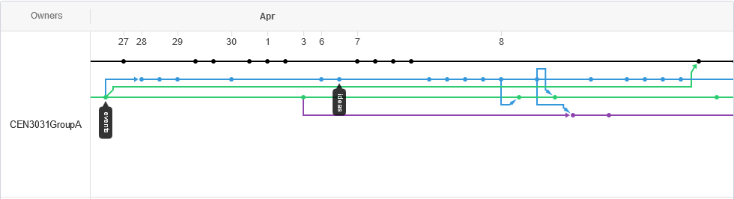
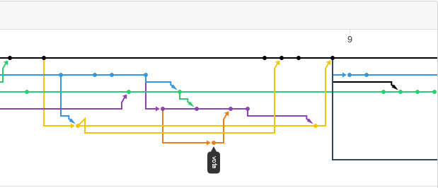
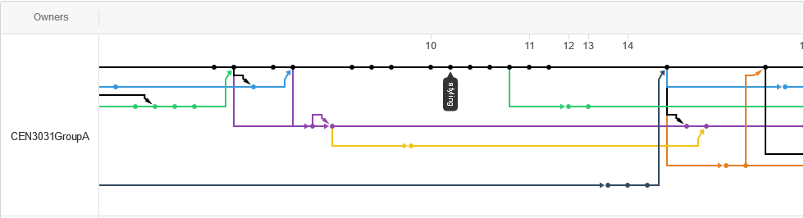
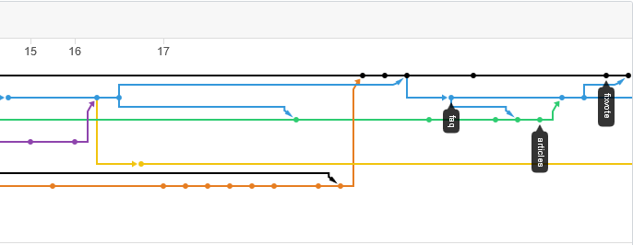
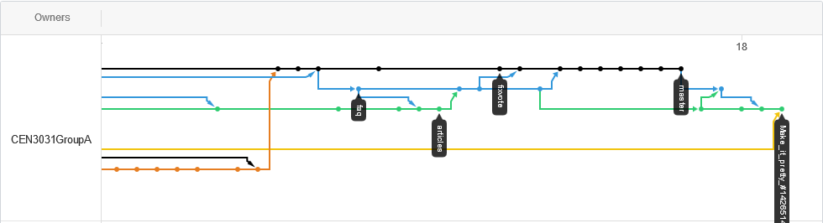
GitHub Activity

Slide 16
Testing and Release
Testing has been done purely through peer review up to this point. Most bugs found have been corrected when discovered.
A released version of the currently working App can be found here:
https://still-eyrie-27550.herokuapp.com/
You can use travis+admin@gmail.com and password = 1234 to login

